Slide 1
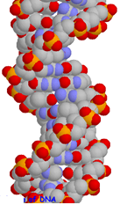
Evolutionary Computation
Natural Genetics
Natural Evolution
Evolutionary Algorithms
Genetic algorithms
Evolutionary programming
Genetic programming
Particle swarm optimization
Applications of EAs

Slide 2
Natural Genetics
The information required to build a living organism is coded in the DNA of that organism
Genotype (DNA inside) determines phenotype
Genes → phenotypic traits is a complex mapping
One gene may affect many traits (pleiotropy)
Many genes may affect one trait (polygeny)
Small changes in the genotype lead to small changes in the organism (e.g., height, hair colour)
Notes:
"Genotype" is an organism's full hereditary information. "Phenotype" is an organism's actual observed properties

Slide 3
Genes and the Genome
Genes are encoded in strands of DNA called chromosomes
In most cells, there are two copies of each chromosome (diploidy)
The complete genetic material in an individual’s genotype is called the Genome
Within a species, most of the genetic material is the same

Slide 4
Example: Homo Sapiens
Human DNA is organised into chromosomes
Human body cells contains 23 pairs of chromosomes which together define the physical attributes of the individual:

Slide 5
Reproductive Cells
Gametes (sperm and egg cells) contain 23 individual chromosomes rather than 23 pairs
Cells with only one copy of each chromosome are called Haploid
Gametes are formed by a special form of cell splitting called meiosis
During meiosis the pairs of chromosome undergo an operation called crossing-over
Notes:
Meiosis تقسیم سلولی

Slide 6
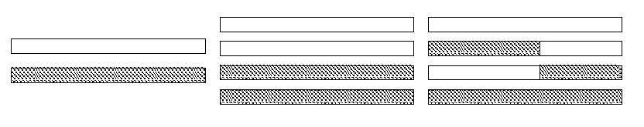
Crossing-over during meiosis
Chromosome pairs align and duplicate
Inner pairs link at a centromere and swap parts of themselves
Outcome is one copy of maternal/paternal chromosome plus two entirely new combinations
After crossing-over one of each pair goes into each gamete

Slide 7
Fertilisation
Sperm cell from Father
Egg cell from Mother
New person cell (zygote)

Slide 8
Natural Evolution

Slide 9
Natural Evolution as a Problem Solving Method
The theory is given:
a population of organisms that can reproduce (generate new organisms) in a challenging/changing environment
(… their chances of reproduction depends on how well they cope with their environment)
a way of continually generating diversity in new `child’ organisms (so –new organisms are not simply copies of old ones)
A `survival of the fittest’ principle will naturally emerge: future generations will have mixes of characteristics that tend to go along with being good at surviving in this environment.

Slide 10
Natural Selection
Limited number of resources
Competition results in struggle for existence
Success depends on fitness --
fitness of an individual: how well-adapted an individual is to their environment
This is determined by their genes (blueprints for their physical and other characteristics).
Successful individuals are able to reproduce and pass on their genes

Slide 11
When changes occur ...
Previously “fit” (well-adapted) individuals will no longer be best-suited for their environment
Some members of the population will have genes that confer different characteristics than “the norm”
Some of these characteristics can make them more “fit” in the changing environment.

Slide 12
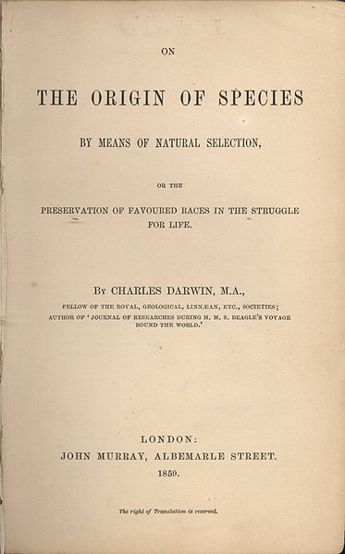
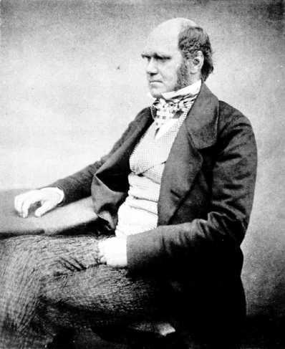
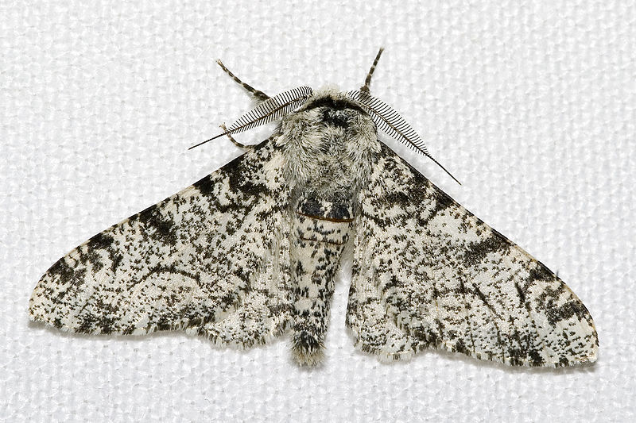
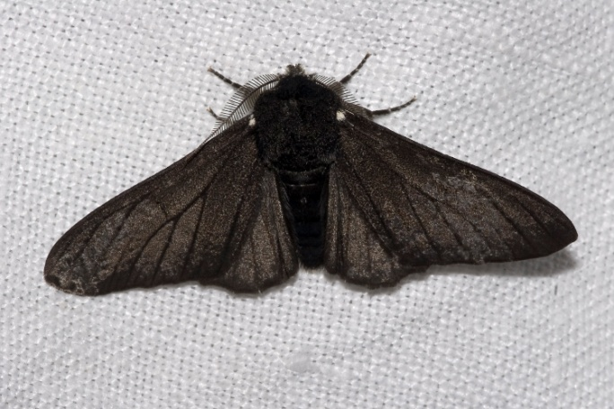
Evolution/Survival of the Fittest
The theory of evolution is the statement that all species on Earth have arisen in this way by evolution from one or more very simple self-reproducing molecules in the primeval soup. I.e. we have evolved via the accumulation of countless advantageous (in context) mutations over countless generations, and species have diversified to occupy environmental niches, as a result of different environments favouring different mutations (1859)

Slide 13
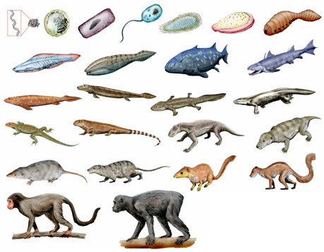
Evolving

Slide 14
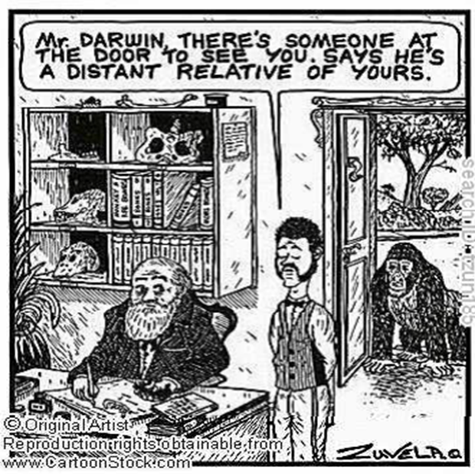

Slide 15
Evolution as an Optimization Method
Can view evolution as a way of solving the problem:
How can I best survive in this environment?
The basic method of it is trial and error. I.e. evolution is in the family
of methods that do something like this:
1. Come up with a new solution by randomly changing an old one.
Does it work better than previous solutions? If yes, keep it and
throw away one of the old ones. Otherwise, discard it.
2. Go to 1.
But this appears to be a recipe for problem solving algorithms which take forever, with little or no eventual success!

Slide 16
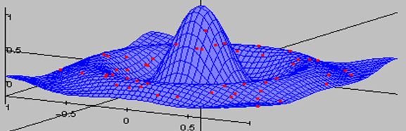
The Magic Ingredients
Lesson0: Natural evolution is driven by a complex environment – essentially this calculates an organism’s ‘fitness’ over its
lifetime. We can replace that with a much faster calculation!
Lesson1: Keep a population/collection of different things on the go.
Lesson2: Select `parents’ with a relatively weak bias towards the
fittest.
It’s not really plain survival of the fittest, what works is
the fitter you are, the more chance you have to reproduce,
and it works best if even the least fit still have some chance.

Slide 17
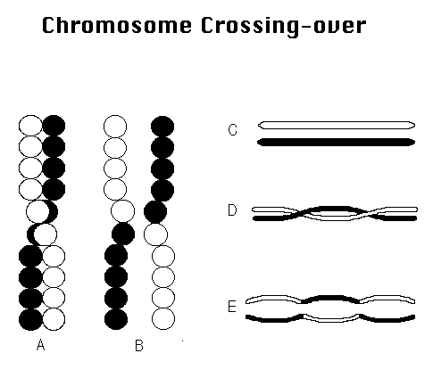
The Magic Ingredients
Lesson3: Use randomised Mutation and/or Recombination (aka crossover) to generate new candidate solutions from the selected ‘parents’
Mutation may be due to
various sources (e.g. UV rays,
chemicals, etc.)

Slide 18
When to Use EC Strategies
When space to be searched is too big
search won’t return within our lifetimes, these types of problems are better solved using a parallel approach
When the “best” solution is not necessarily required
Approach to solving a problem not well-understood
Problems with many parameters that need to be simultaneously optimized
Problems that are difficult to describe mathematically

Slide 19
EC Paradigms are Unique
EC paradigms differ from traditional search and optimization paradigms in that EC paradigms:
Use a population of points in their search,
2) Use direct “fitness” information, instead of function derivatives or other related knowledge, and ,
3) Use probabilistic rather than deterministic transition rules.

Slide 20
Probabilistic Transition Rules
Search is not random
Search is directed toward regions that are likely to have higher fitness values
Different EC paradigms make different uses of stochasticity

Slide 21
A Generic Evolutionary Algorithm
Suppose you have to find a solution to some problem or other, and suppose, given any candidate solution s you have a fitness function f(s) which measures how good s is as a solution to your problem.
Generate an initial population P of randomly generated solutions (this is typically 100 or 500 or so). Use f(s) to evaluate the fitness of each. Then:
Repeat until a termination condition is reached:
Selection: Choose some of P to be parents
Variation: Apply ‘genetic operators’ to the parents to produce some children, and then evaluate the fitness of the children.
Population update: Update the population P by retaining some of the children and removing some of the incumbents.

Slide 22
Some of main questions:
How to select?
Always select the best? Bad results, quickly
Select almost randomly? Great results, too slowly
There are many different ways to select – e.g. choose top
10% of the population; choose with probability proportionate
to fitness; choose randomly from top 20%, etc …
How to encode?
The ‘Encoding’ or ‘Representation’, is the approach used to specify a solution as a data structure.
How to vary?
(mutation, recombination, etc…)
small-step mutation preferred, recombination seems
to be a principled way to do large steps, but large
steps are usually abysmal

Slide 23
chromosomes
GAs work with a population of individuals (chromosomes)
Number of elements in each individual equals the number of parameters in the optimization problem
Parameters often encoded as binary strings
Any finite alphabet can be used
Typically, population member string is of fixed length
If w is the number of parameters, and we have b bits per parameter, then the search space is 2^{wb}

Slide 24
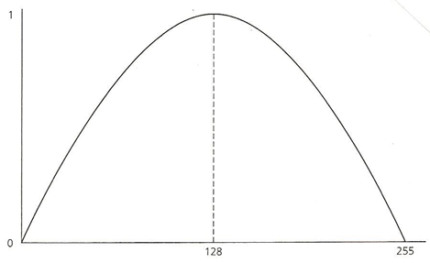
GA Example Problem
Optimize value of
over
where x is restricted to integers.
The maximum value of 1 occurs at x = 128.
Note: Function space is identical to fitness space.

Slide 25
GA Example Problem
One variable
Use binary alphabet
Therefore, represent each individual as 8-bit binary string
Set number of population members to (artificially low) 8
Randomize population
Calculate fitness for each member of (initialized) population

Slide 26
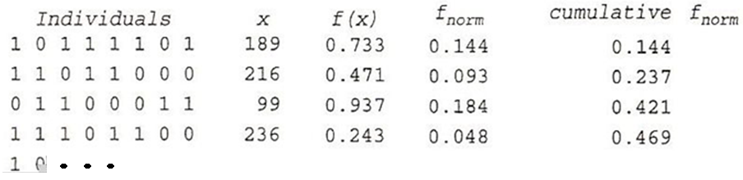
GA Example Problem

Slide 27
GA Example Problem - Reproduction
Reproduction is used to form new population of n individuals
Select members of current population
Use stochastic process based on fitnesses
First, compute normalized fitness value for each individual by
dividing individual fitness by sum of all fitnesses
(f_{i} / 5.083 in the example case)
Generate a random number between 0 and 1 n times to form
new population

Slide 28
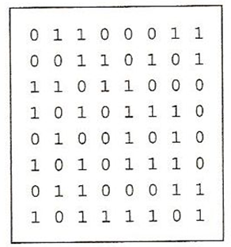
Population after Reproduction
The eight random numbers generated, presented in random order, are .293, .971, .160, .469, .664, .568, .371, and .109. This results in initial population member numbers 3, 8, 2, 5, 6, 5, 3, and 1 being chosen to make up the population after reproduction, as shown below.

Slide 29
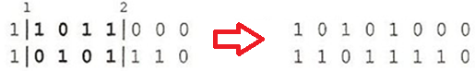
Crossover
Two-point crossover, with p(c) of 60-80% is common (75% used here)
Randomly pair off population, determine whether or not crossover will occur (in example, 3 of 4 crossover)
Randomly select two crossover points for pairs undergoing crossover
Exchange portions of strings between 1st and 2nd crossover points, treating individuals as “ring” structures

Slide 30
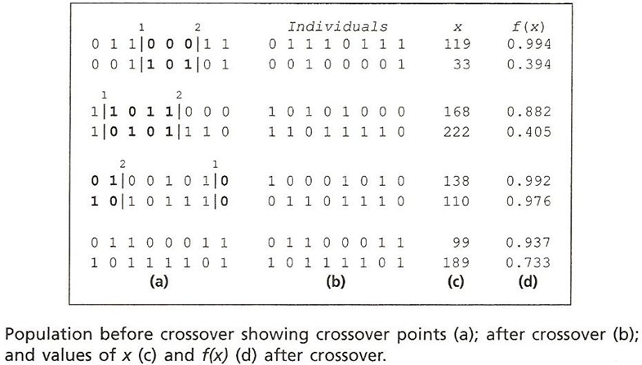
Crossover: Before and After

Slide 31
Other crossover methods
The most basic crossover is one-point:
10110|010 > 10110100
01001|100 > 01001010
Uniform crossover (Syswerda):
- Randomly choose 2 parents & stochastically decide
whether to do crossover
- At each bit position, exchange bits between the 2
strings with p(c) <= 50% [constant for run]
Often start with relatively high crossover rate, and reduce it during
the run

Slide 32
GA Example Problem: Mutation
Mutation is final operation in GAs
Consists of flipping bits with probability of flip ~ .001 - .01
In this example, assume no bit flips (64 bits total in population)
Now have first generation, with total fitness of 6.313, and two individuals each with fitness > .99
Now ready for more generations until stopping condition met:
* Number of generations
* Population member(s) with > specified fitness
* No change in max fitness in n generations

Slide 33
Representation of Variables
Consider example problem,
where 127 is 01111111 and 128 is 10000000
The smallest fitness change requires change in every bit !
Gray coding has representation such that adjacent values vary by a single bit
Different alphabets possible

Slide 34
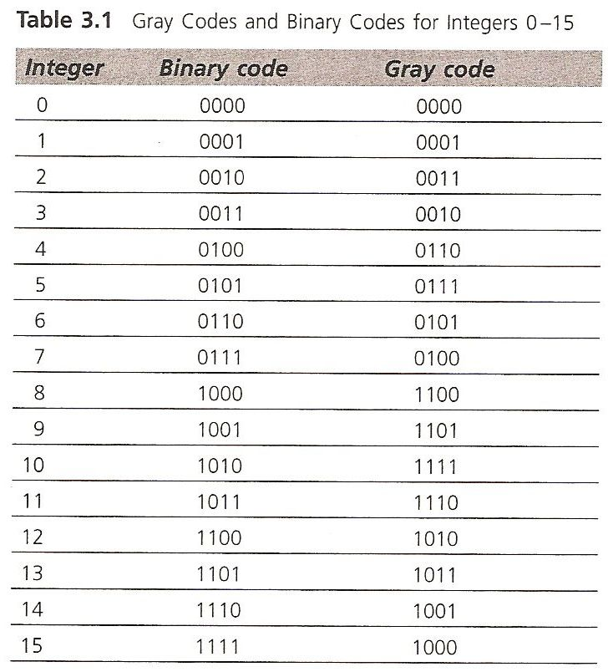
Gray Coding
To get Gray code from binary code, the leftmost bit is the same, then
G_{i} = XOR(B_{i}, B_{i-1}) for i>=2, where G_{i} is the i^{th} Gray code bit, Bi is i^{th} binary bit.

Slide 35
Dynamic Range and Resolution
Some software allows you to set the dynamic range and resolution for each variable.
Example: Dynamic range is 2.5 to 4.5, and you want a resolution of 3 decimal places (1 in 1000), you need 11 bits.
Problems can occur: If we have a dynamic range of 5 and a resolution of 3 decimal places, then we need 13 bits, the same as for a dynamic range of 8
We can now get numbers from crossover and mutation out of range, and repairs or penalties must be implemented.

Slide 36
Individual Encoding
Bit strings (0101 ... 1100)
Real numbers (43.2 -33.1 ... 0.0 89.2)
Permutations of element (E11 E3 E7 ... E1 E15)
Lists of rules (R1 R2 R3 ... R22 R23)
Program elements (genetic programming)
... any data structure ...

Slide 37
Population Size
Start with moderate sized population
50-500 is often a good starting place for a GA
Population size tend to increase linearly with individual string length (not exponentially)
Population typically remains the same size
Operators such as crossover and mutation significantly enhance parallel search capabilities

Slide 38
Population Initialization
Usually selected stochastically
Sometimes seeded with a few promising individuals
Do not skew population significantly

Slide 39
Fitness Calculation
Most GAs scale fitness values
Example problem
illustrates two common problems:
1. “Bunching” of fitness values near top of
scale, thereby lowering fitness differentials
2. Fitness values often are nearly constant

Slide 40
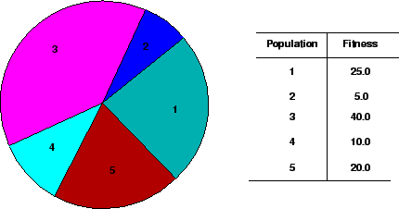
Reproduction
Reproduction often done by normalizing fitnesses and generating n random numbers between 0 and 1
Baker’s method: Use roulette wheel with n pointers spaced 1/n apart; use normalized fitness; spin wheel once.

Slide 41
Reproduction
Generation gap approach: Replace x percent that have worst fitness values (x is defined as the generation gap)
use with large populations
“Elitist strategy” ensures that individual with highest fitness is copied into next generation (most GAs use this)

Slide 42
Reproduction
“Tournament selection”
All methods above rely on global population statistics
Could be a bottleneck esp. on parallel machines
Relies on presence of external fitness function which might not exist: e.g. evolving game players
Informal Procedure:
Pick k members at random then select the best of these
Repeat to select more individuals

Slide 43
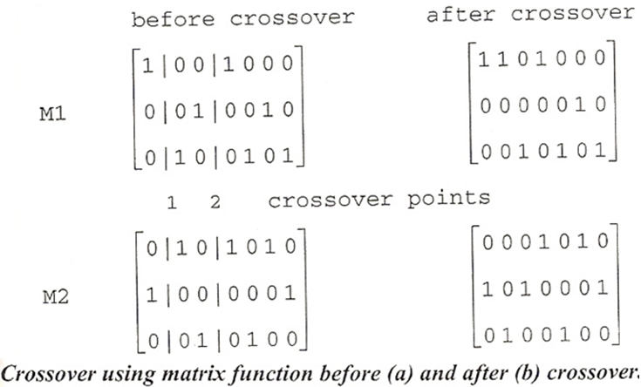
Matrix Crossover
Working with a population of c by n matrices, where c = no. of classes and n is number of patterns -Bezdek (1994)
Each matrix represents classes assigned to all patterns (each column represents a pattern; only one 1 is allowed in each column)
This case is analogous to working with strings that have an alphabet of c characters
c=3
n=7

Slide 44
Crossover Operators
Performance with 1 Point Crossover depends on the order that variables occur in the representation
more likely to keep together genes that are near each other
Can never keep together genes from opposite ends of string
This is known as Positional Bias
Can be exploited if we know about the structure of our problem, but this is not usually the case

Slide 45
Inversion
Single parent produces single child
Not used much today...it destroys “schemata” (defined later)
Example: 10|01101|0 -> 10100100

Slide 46
Mutation
Stochastically flipping bits often with p(m) ~ .001
If real-valued parameters used, mutation can assign any
value in parameters allowed range
Probability of mutation usually held constant or increased
during run
Can increase mutation rate when fitness variablility drops
below some threshold

Slide 47
Selecting the Number of Generations
Often a trial and error process
Optimum value (if known) a function of the problem
Multiple runs often done; overall best solution selected
To achieve the desired results, 500 to 5000 generations are required

Slide 48
Example:
Initial population

Slide 49
Select

Slide 50
Crossover

Slide 51
Another Crossover

Slide 52
A mutation

Slide 53
Another Mutation

Slide 54
Old population + children

Slide 55
New Population: Generation 2

Slide 56
Generation 3

Slide 57
Generation 4, etc …

Slide 58
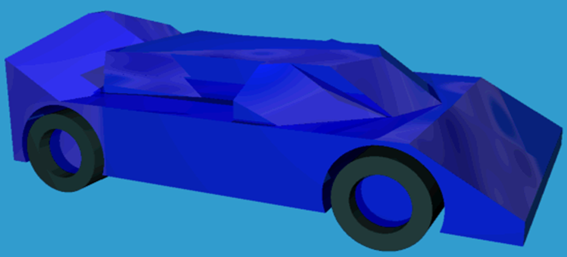
Example2: Bentley.s thesis work
Fixed wheel positions, constrained bounding area,
Chromosome is a series of slices
fitnesses evaluated via a simple airflow simulation

Slide 59
An Abstract Example
Distribution of Individuals in Generation 0
Distribution of Individuals in Generation N

Slide 60
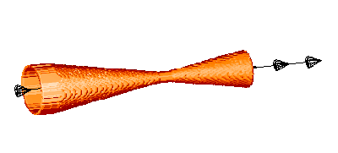
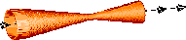
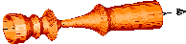
Example3: One of the very first applications. Determine the internal shape of a two-phase jet nozzle that can achieve the maximum possible thrust under given starting conditions
Ingo Rechenberg was the very first, with pipe-bend design. This is slightly later work in the same lab, by Schwefel
Starting point
EA (ES) running
Result
A recurring theme: design freedom → entirely new and better designs based on principles we don’t yet understand.

Slide 61
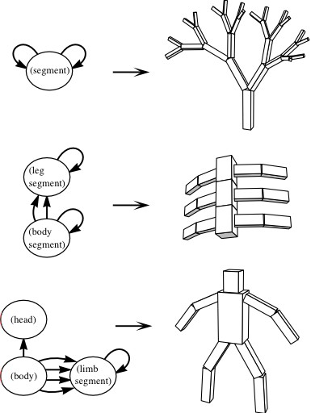
Example4: Forming body plans with evolution
Node specifies part type,
joint, and range of movement
Edges specify the joints between parts
Population?
Graphs of nodes and edges
Selection?
Ability to perform some task
(walking, jumping, etc.)
Mutation?
Node types change/
new nodes grafted on

Slide 62
Example: TSP
Representation is an ordered list of city
numbers known as an order-based GA.
1) London 3) Iowa City 5) Beijing 7) Tokyo
2) Venice 4) Singapore 6) Phoenix 8) Victoria
CityList1 (3 5 7 2 1 6 4 8)
CityList2 (2 5 7 6 8 1 3 4)

Slide 63
Crossover
Crossover combines inversion and recombination:
Parent1 (3 5 7 2 1 6 4 8)
Parent2 (2 5 7 6 8 1 3 4)
Child (5 8 7 2 1 6 3 4)
Copy a randomly selected portion of Parent1 to Child
Fill the blanks in Child with those numbers in Parent2 from left to right, as long as there are no duplication in Child.
This operator is called the Order1 crossover.

Slide 64
Mutation
Mutation involves swapping two numbers of the list:
* *
Before: (5 8 7 2 1 6 3 4)
After: (5 8 6 2 1 7 3 4)

Slide 65
TSP Example: 30 Cities

Slide 66
Solution _{i} (Distance = 941)

Slide 67
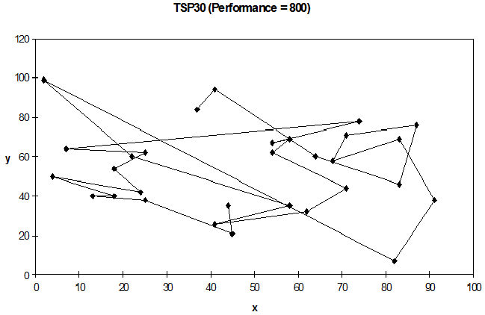
Solution _{j}(Distance = 800)

Slide 68
Solution _{k}(Distance = 652)

Slide 69
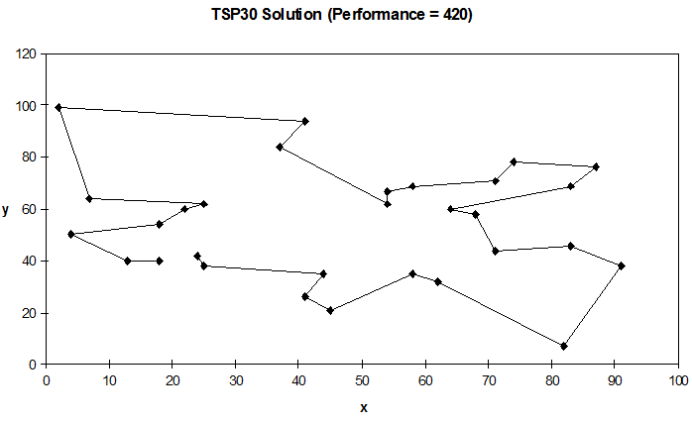
Best Solution (Distance = 420)

Slide 70
Overview of Performance

Slide 71
Typical run: progression of fitness
Best fitness in population
Time (number of generations)
Typical run of an EA shows so-called “anytime behavior”

Slide 72
Are long runs beneficial?
Progress in 2nd half
Best fitness in population
Progress in 1st half
Time (number of generations)
Answer:
- it depends how much you want the last bit of progress
- it may be better to do more shorter runs

Slide 73
Is it worth expending effort on smart initialisation?
Best fitness in population
F
F: fitness after smart initialisation
T: time needed to reach level F after random initialisation
T
Time (number of generations)
Answer : it depends:
- possibly, if good solutions/methods exist.
- care is needed

Slide 74
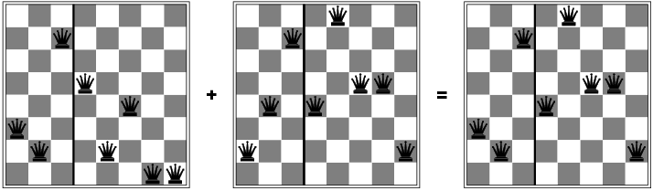

Slide 76
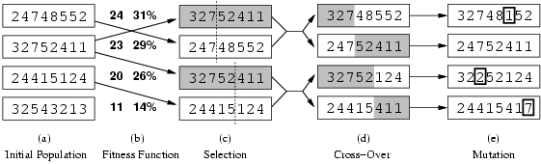
Example: 8-Queens
Fitness function: number of non-attacking pairs of queens (min = 0, max = 8 × 7/2 = 28)
24/(24+23+20+11) = 31%
23/(24+23+20+11) = 29% etc
Normalized Fitness

Slide 77
Crossover OR mutation?
Decade long debate: which one is better / necessary / main-background
Answer (at least, rather wide agreement):
it depends on the problem, but
in general, it is good to have both
both have another role
mutation-only-EA is possible, xover-only-EA would not work

Slide 78
Crossover OR mutation? (cont’d)
Exploration: Discovering promising areas in the search space, i.e. gaining information on the problem
Exploitation: Optimising within a promising area, i.e. using information
There is co-operation AND competition between them
Crossover is explorative, it makes a big jump to an area somewhere “in between” two (parent) areas
Mutation is exploitative, it creates random small diversions, thereby staying near (in the area of ) the parent

Slide 79
Crossover OR mutation? (cont’d)
Only crossover can combine information from two parents
Only mutation can introduce new information (alleles)
Crossover does not change the allele frequencies of the population (thought experiment: 50% 0’s on first bit in the population, ?% after performing n crossovers)
To hit the optimum you often need a ‘lucky’ mutation

Slide 80
When NOT to use a GA?
if global optimality is required
if problem insight can:
significantly impact algorithm performance
simplify problem representation
if the problem is highly constrained
if the problem is smooth and convex
use a gradient-based optimizer
if the search space is very small
use enumeration

